Slide 1
EMPLOYEE SALARY PREDICTION using Random forest regressor
CAPSTONE PROJECT
Presented By :
DERANGULA VENKATA LOKESH
YSR ENGINEERING COLLEGE OF YVU- CSE
AICTE ID: STU6799c9262be3f1738131750

Slide 2
Problem Statement
Develop a machine learning model to predict employee salaries.
Factors used : Age, Gender, Years of Experience, Education Level , Job Title.
Deploy as a user-friendly Streamlit web app for transparency and fairness.

Slide 3
System Approach
Hardware : Computer with 16GB RAM, multi-core processor.
Software : Python 3.8, Jupyter Notebook,Streamlit.
Data : employee_salary.csv
Environment : Python with pip and Jupyter notebook with conda
Interface : A Streamlit app for taking input and Predicting salaries.
Libraries : Pandas, NumPy, Scikit-learn, Mathplotlib , Streamlit, Seaborn, Joblib.

Slide 4
Algorithm & Deployment
Preprocessing :
• Cleaning data, removing null values, converting categoric to numeric.
• Creating Exp_to_Age feature (Experience / Age).
Model Development :
• Random Forest Regressor in a Pipeline.
• Scale numerical features, encode categorical features.
• Train on 80% data, test on 20%.
Deployment :
• Streamlit app with sliders/dropdowns.
• Load model and dataset for predictions
• Deploy locally or on Streamlit Cloud.

Slide 5
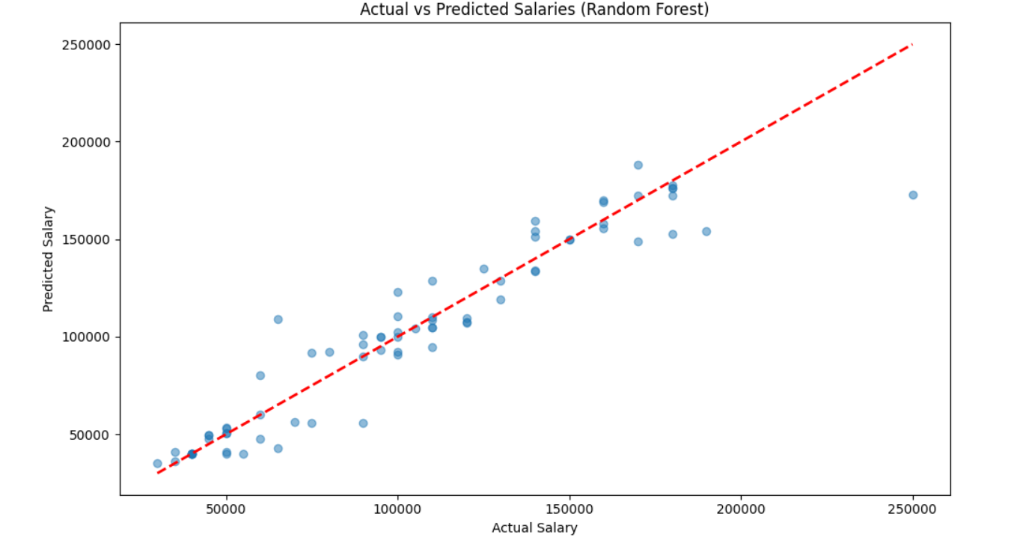
Result
https://github.com/lokesh-derangula/Employee-Salary-Prediction

Slide 6
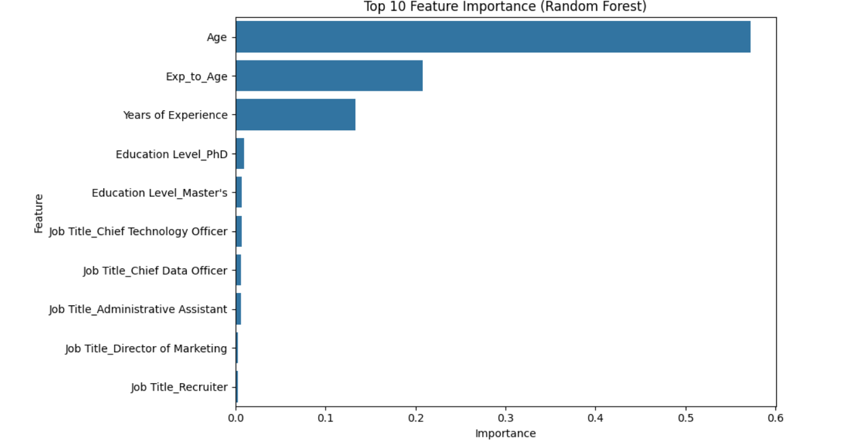
Result
https://github.com/lokesh-derangula/Employee-Salary-Prediction

Slide 7
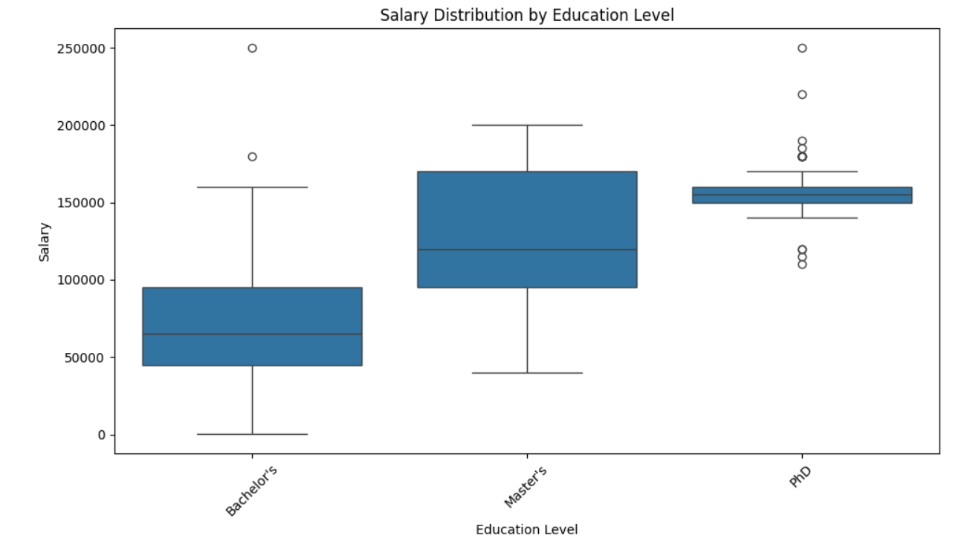
Result
https://github.com/lokesh-derangula/Employee-Salary-Prediction

Slide 8
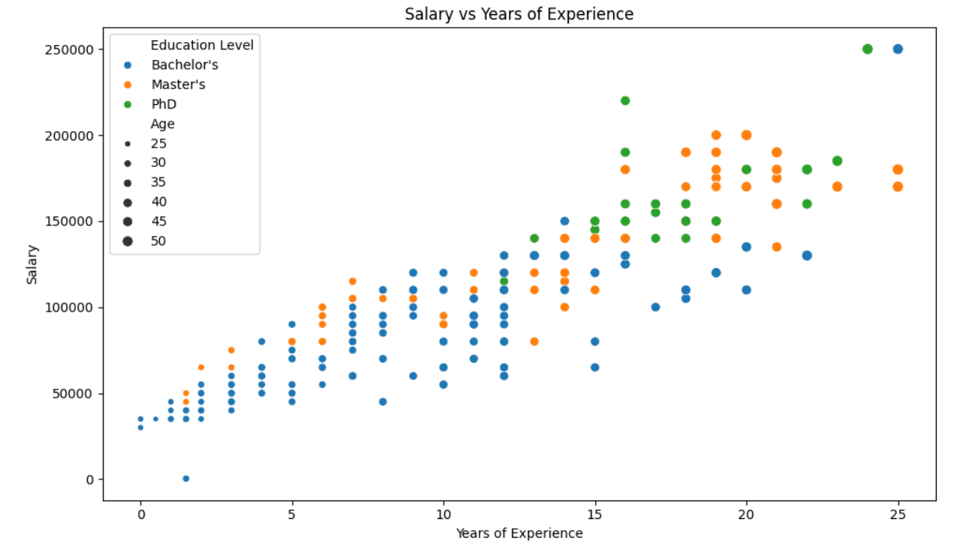
Result
https://github.com/lokesh-derangula/Employee-Salary-Prediction

Slide 9
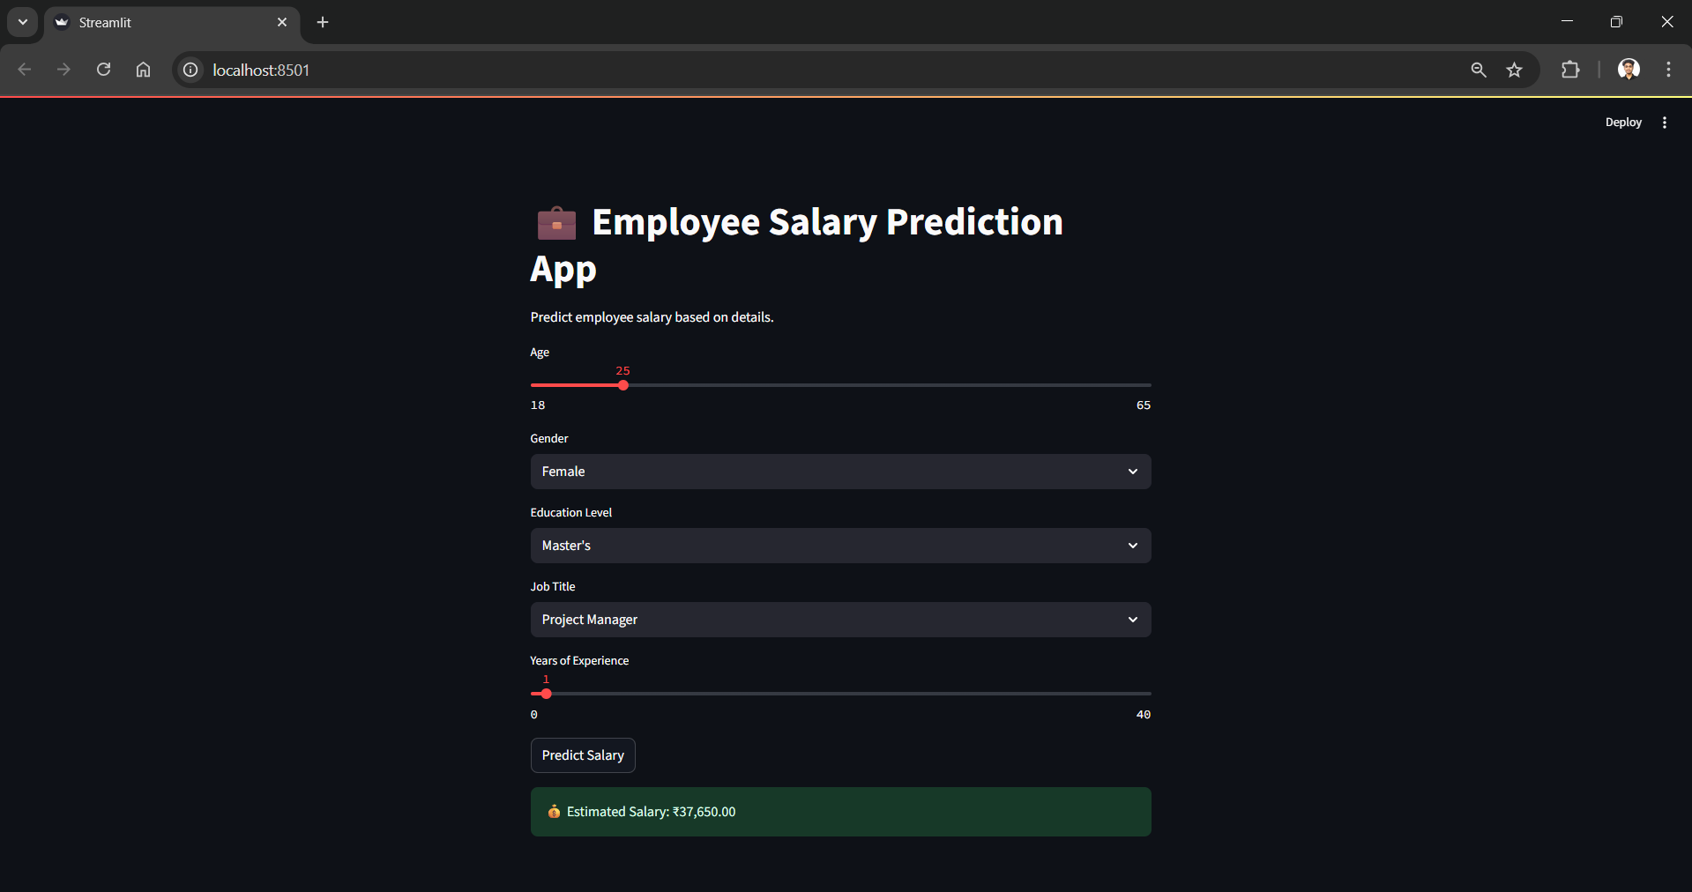
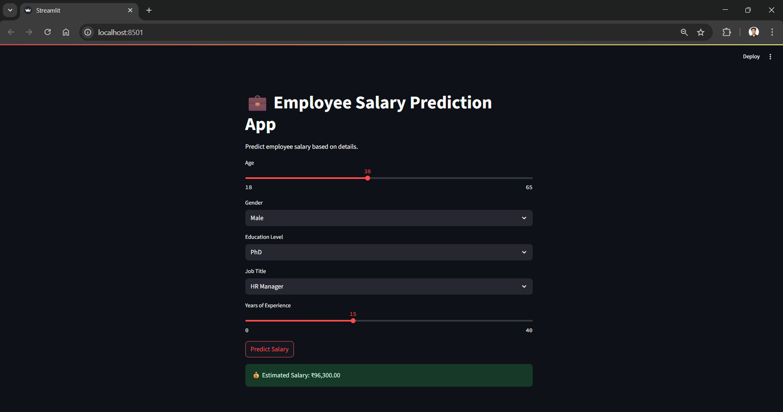
Result
https://github.com/lokesh-derangula/Employee-Salary-Prediction

Slide 10
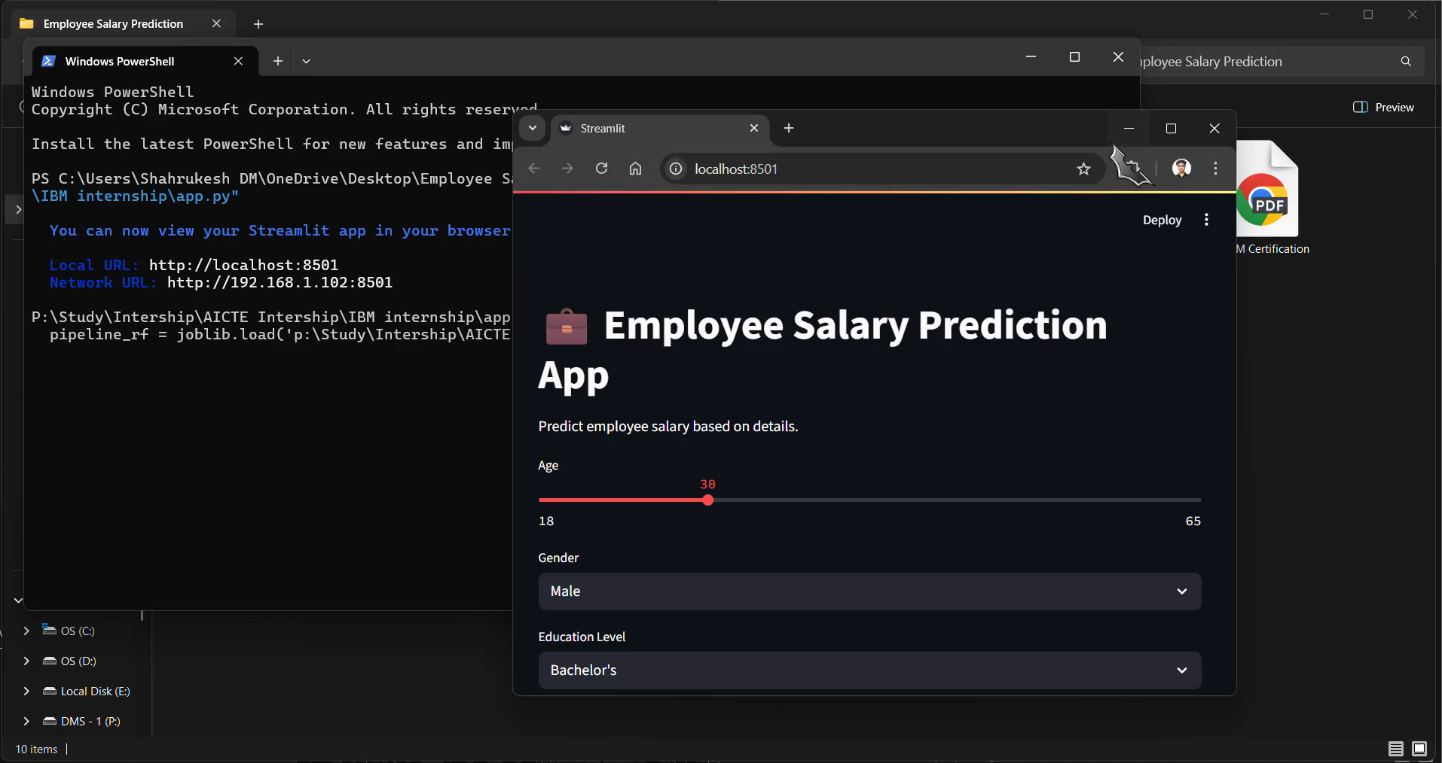
Result - Video
https://github.com/lokesh-derangula/Employee-Salary-Prediction

Slide 11
Conclusion
Built a robust Random Forest model for salary prediction.
Streamlit app ensures accessibility for HR users.
Outperformed Linear Regression in accuracy.
Challenges: Handling high-cardinality Job Titles.
Future: Add features, mitigate bias, enhance scalability.

Slide 12
References
Pandas : https://pandas.pydata.org/docs/
Scikit-learn : https://scikit-learn.org/stable/
Streamlit : https://docs.streamlit.io/
Matplotlib : https://matplotlib.org/stable/contents.html
Seaborn : https://seaborn.pydata.org/
Github link: htttp//github.com/lokesh-derangula/Employee-Salary-Prediction

Slide 13
THANK YOU

